Slide 1
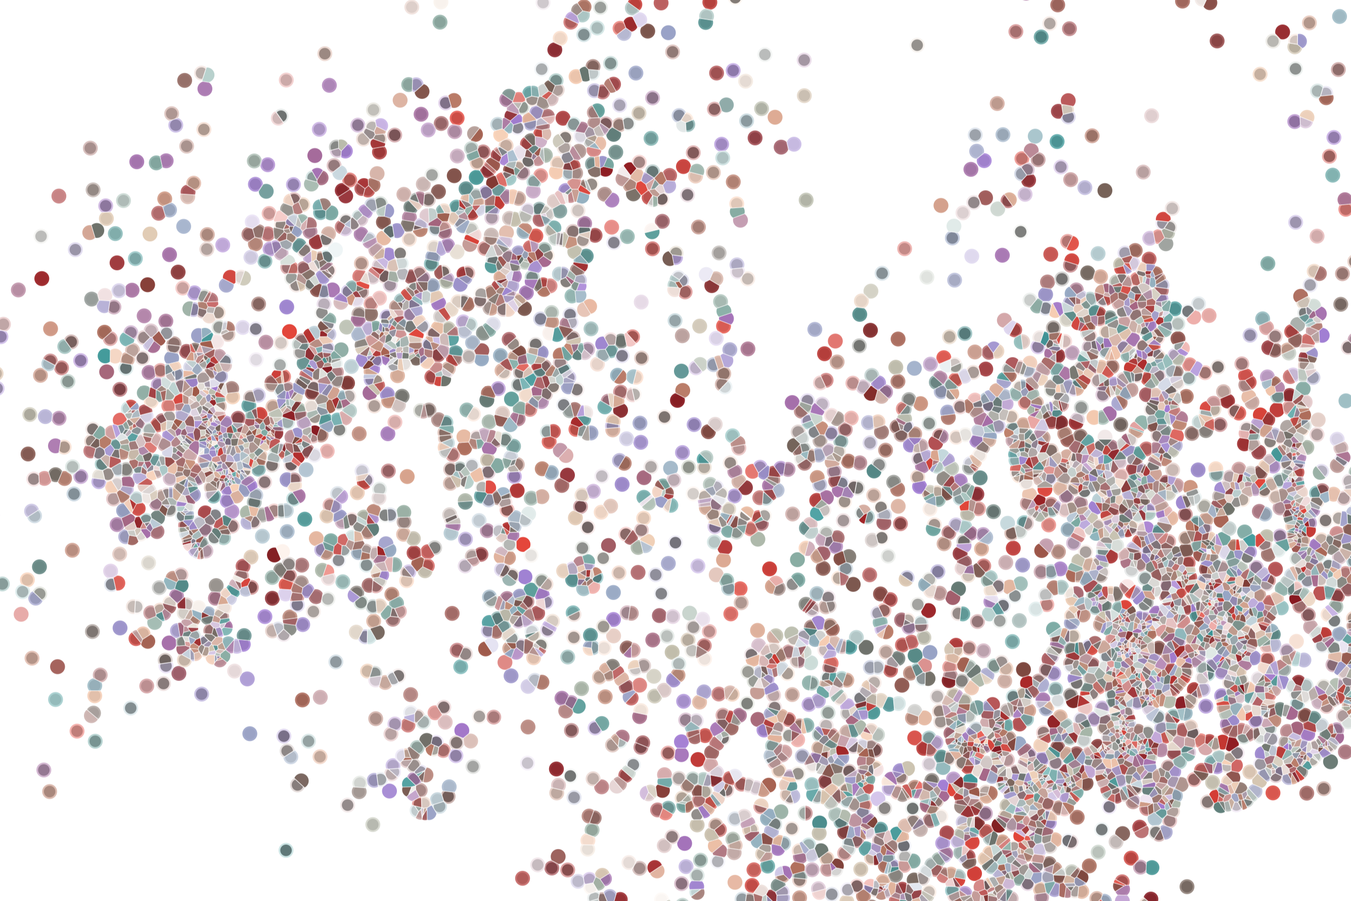
Lecture 6 Annotating cell populations
Physalia course 2021 — Single-cell RNA-seq with R/Bioconductor
Instructors: Jacques Serizay
Notes:
Hello everybody and thank you for attending my presentation. I am going to talk about the project I recently started working on in the Spassky and Koszul labs, both located in Paris. This project focuses on the unusual cooption of the mitotic machinery to drive, not cell division but cell differentiation.

Slide 2

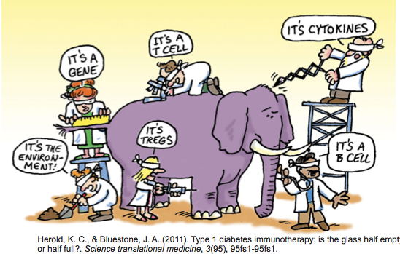
How Do We Define Cellular Identity?
A cell participates in multiple processes/contexts.
2
Notes:
I would like to expand these observations to in vivo data. I also want to check what happens in terms of transcriptional dynamics in cells where Cyclin O, a key non-canonical cyclin involved in MCC diff., is knocked-out.

Slide 3

Analysis workflow
Pre-Processing
Clustering
Biology
Expression Matrix
(GENES x CELLS)
1. Identify
Variable Genes
5. Differentially Expressed Genes
Filter Cells /
Quality Control
2. Dimensionality Reduction
6. Assigning
Cell Type
Normalization
3. Clustering
7. Functional Annotation
4. Explore (known)
marker genes
Notes:
I would like to expand these observations to in vivo data. I also want to check what happens in terms of transcriptional dynamics in cells where Cyclin O, a key non-canonical cyclin involved in MCC diff., is knocked-out.

Slide 4
Analysis workflow
Pre-Processing
Clustering
Biology
Expression Matrix
(GENES x CELLS)
1. Identify
Variable Genes
5. Differentially Expressed Genes
Filter Cells /
Quality Control
2. Dimensionality Reduction
6. Assigning
Cell Type
Normalization
3. Clustering
7. Functional Annotation
4. Explore (known)
marker genes
Notes:
I would like to expand these observations to in vivo data. I also want to check what happens in terms of transcriptional dynamics in cells where Cyclin O, a key non-canonical cyclin involved in MCC diff., is knocked-out.

Slide 5
Analysis workflow
Pre-Processing
Clustering
Biology
Expression Matrix
(GENES x CELLS)
1. Identify
Variable Genes
5. Differentially Expressed Genes
Filter Cells /
Quality Control
2. Dimensionality Reduction
6. Assigning
Cell Type
Normalization
3. Clustering
7. Functional Annotation
4. Explore (known)
marker genes
Notes:
I would like to expand these observations to in vivo data. I also want to check what happens in terms of transcriptional dynamics in cells where Cyclin O, a key non-canonical cyclin involved in MCC diff., is knocked-out.

Slide 6
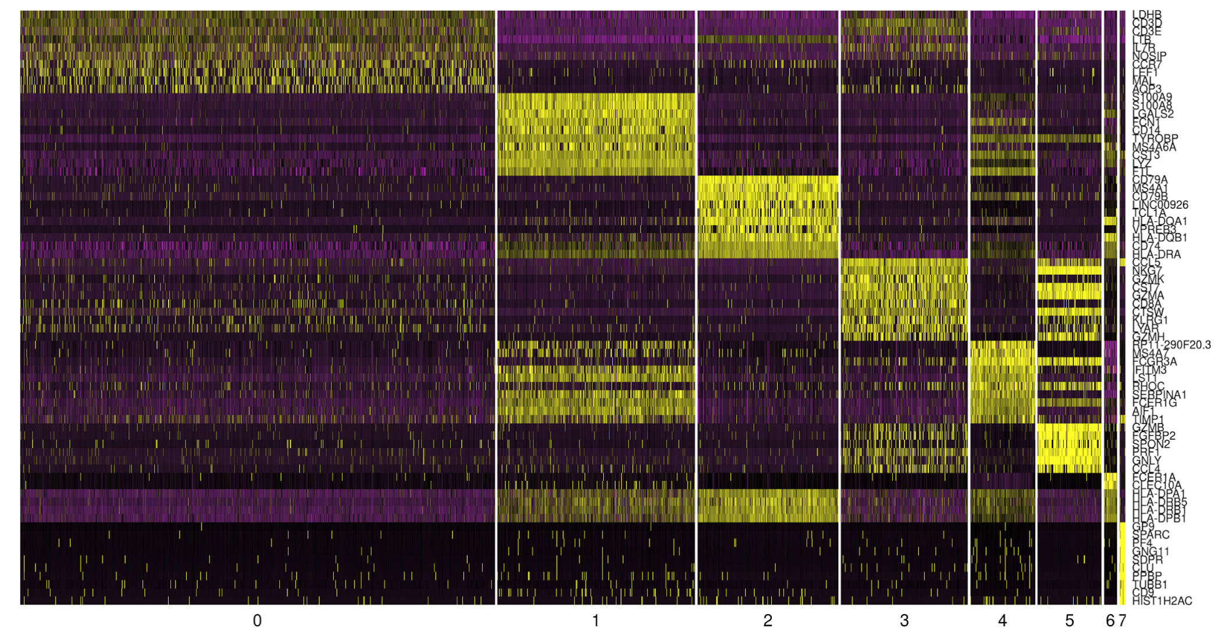
Cell type annotation using identified markers per cluster
Genes
Cell clusters
6
Notes:
I would like to expand these observations to in vivo data. I also want to check what happens in terms of transcriptional dynamics in cells where Cyclin O, a key non-canonical cyclin involved in MCC diff., is knocked-out.

Slide 7
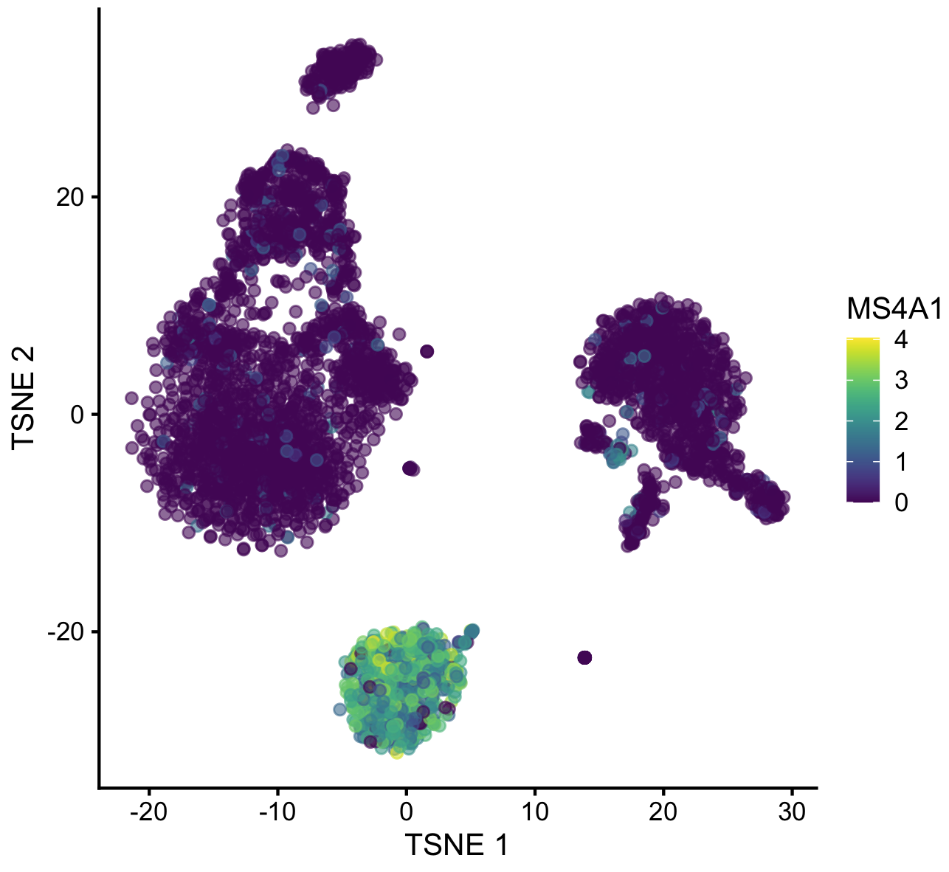
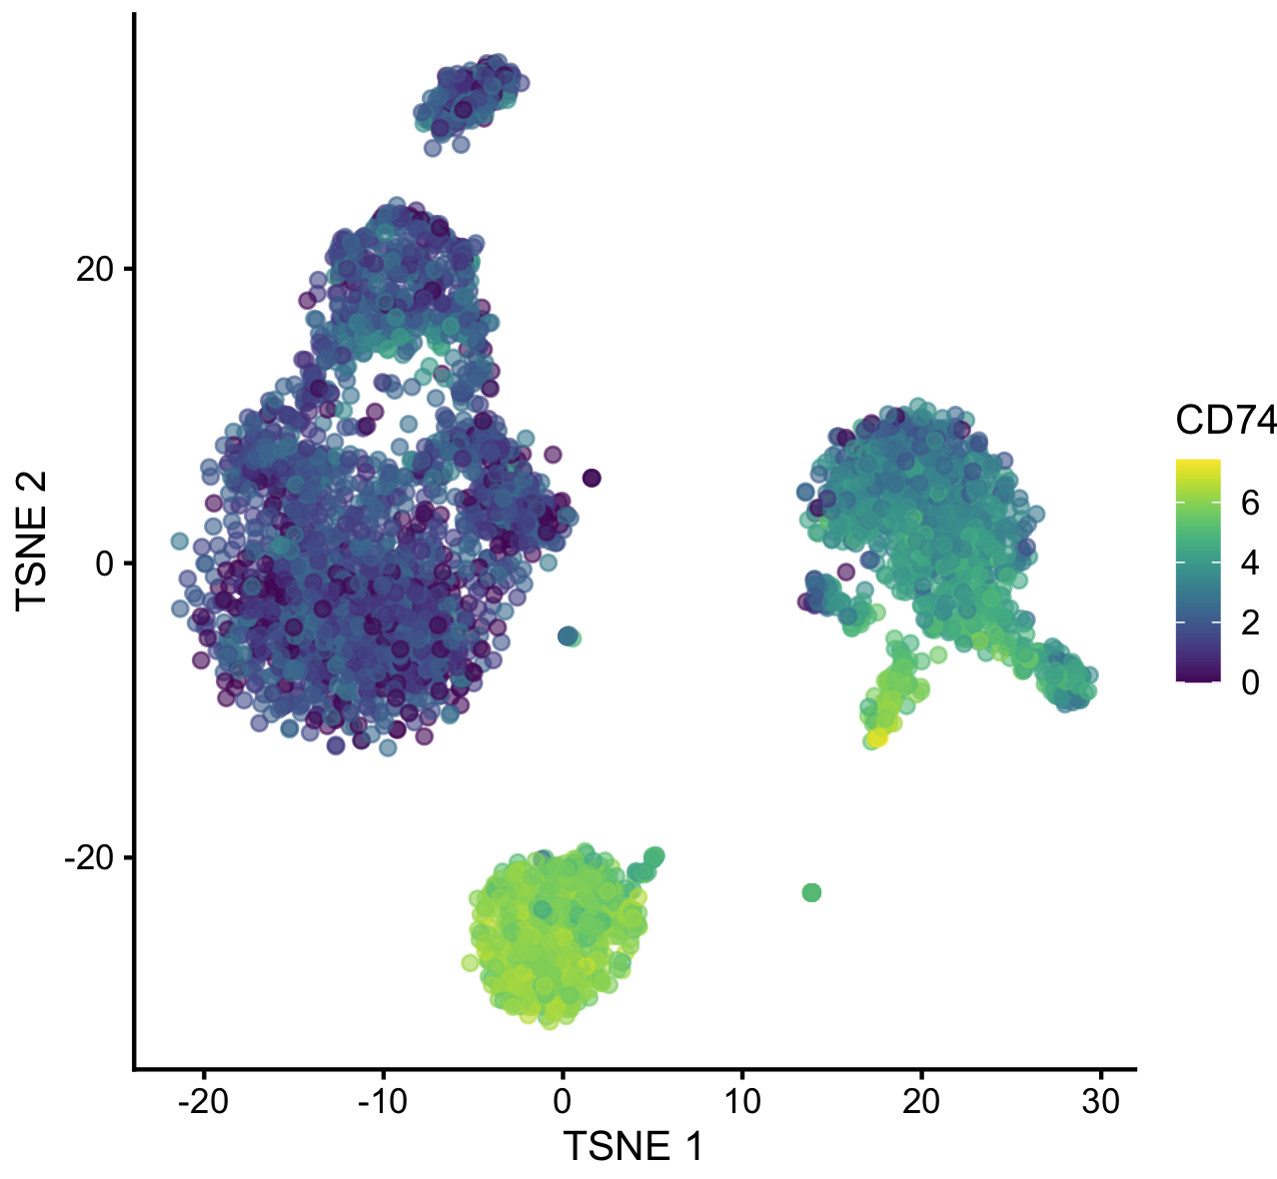
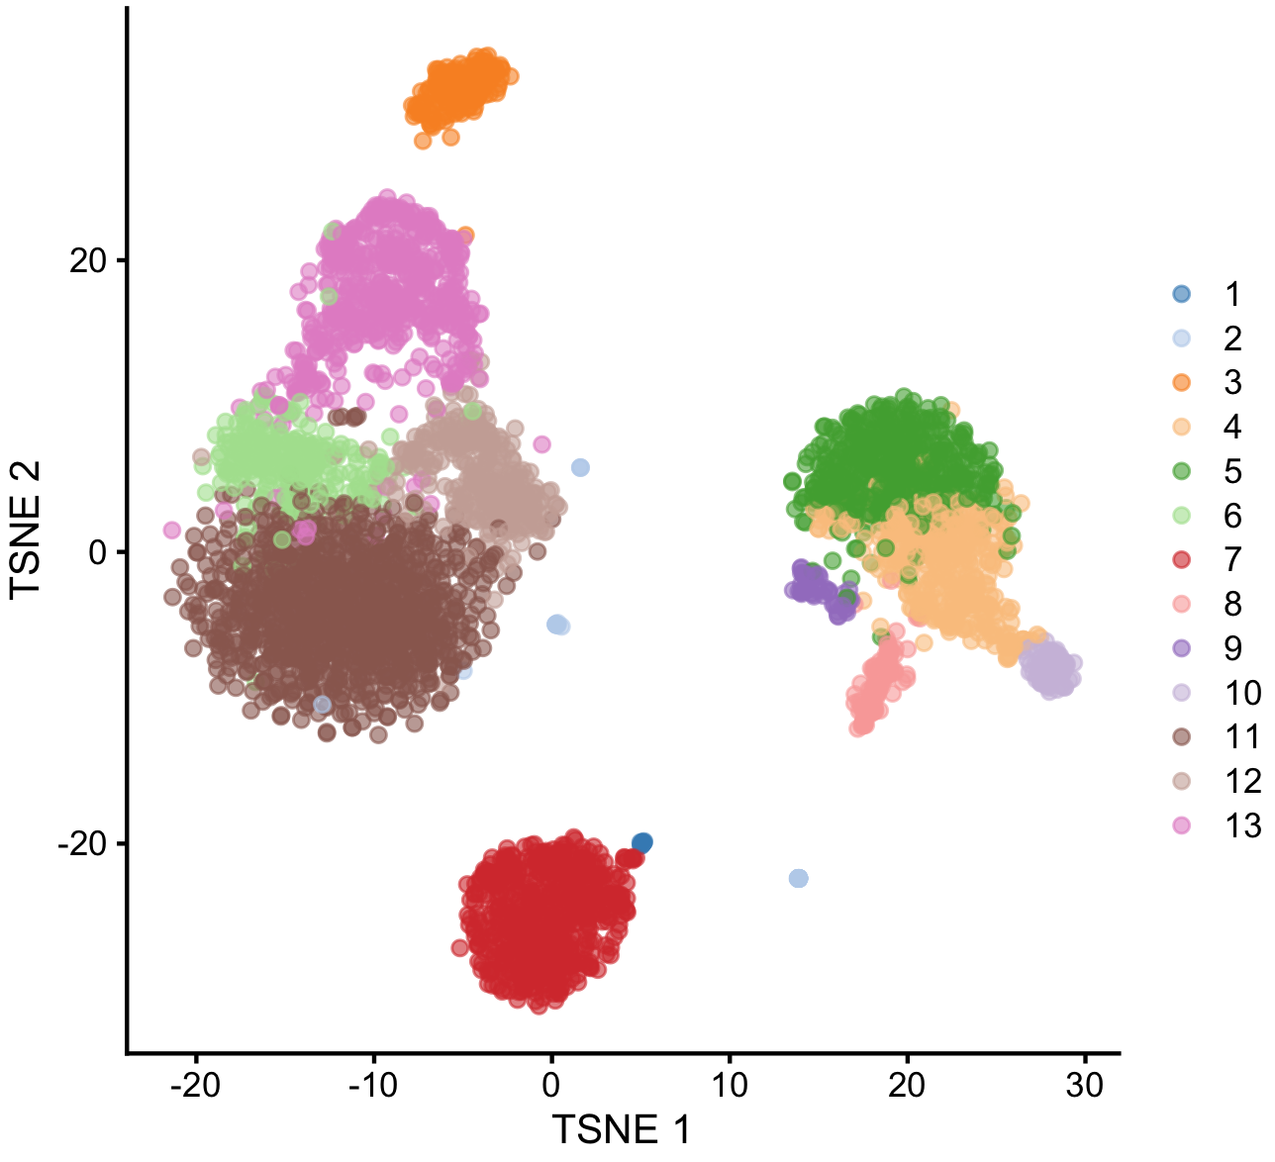
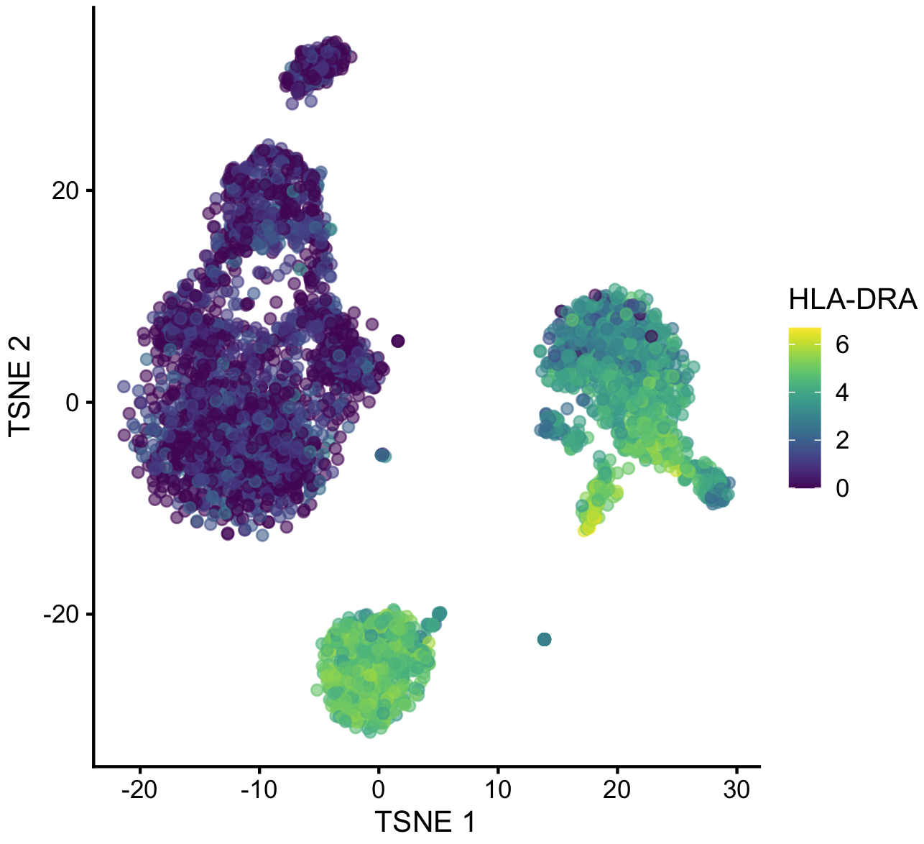

Manual cell type annotation using identified markers per cluster
Top markers of cluster #7 in PBMCs:
CD74
HLA-DRA
MS4A1
CD79A
HLA-DRB1
HLA-DPA1
CD79B
LTB
HLA-DQB1
TCL1A
CD52
HLA-DPB1
CD37
7
Notes:
I would like to expand these observations to in vivo data. I also want to check what happens in terms of transcriptional dynamics in cells where Cyclin O, a key non-canonical cyclin involved in MCC diff., is knocked-out.

Slide 8
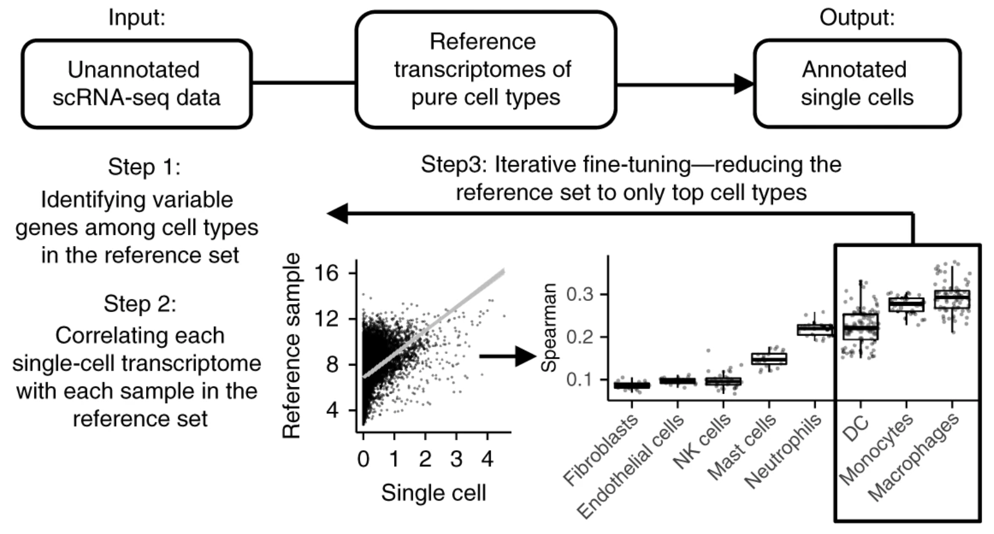
Automated cell type annotation using public marker databases
SingleR can rely on references of pure cell types to annotate individual cells within a scRNAseq dataset.
Aran et al., Nat. Immuno. 2019
8
Notes:
I would like to expand these observations to in vivo data. I also want to check what happens in terms of transcriptional dynamics in cells where Cyclin O, a key non-canonical cyclin involved in MCC diff., is knocked-out.

Slide 9
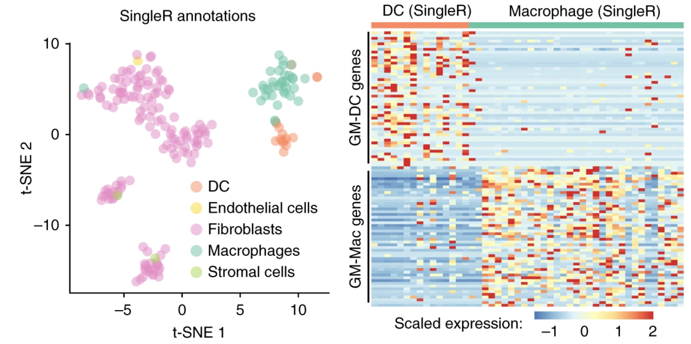
Automated cell type annotation using public marker databases
SingleR can rely on references of pure cell types to annotate individual cells within a scRNAseq dataset.
Aran et al., Nat. Immuno. 2019
9
Notes:
I would like to expand these observations to in vivo data. I also want to check what happens in terms of transcriptional dynamics in cells where Cyclin O, a key non-canonical cyclin involved in MCC diff., is knocked-out.

Slide 10
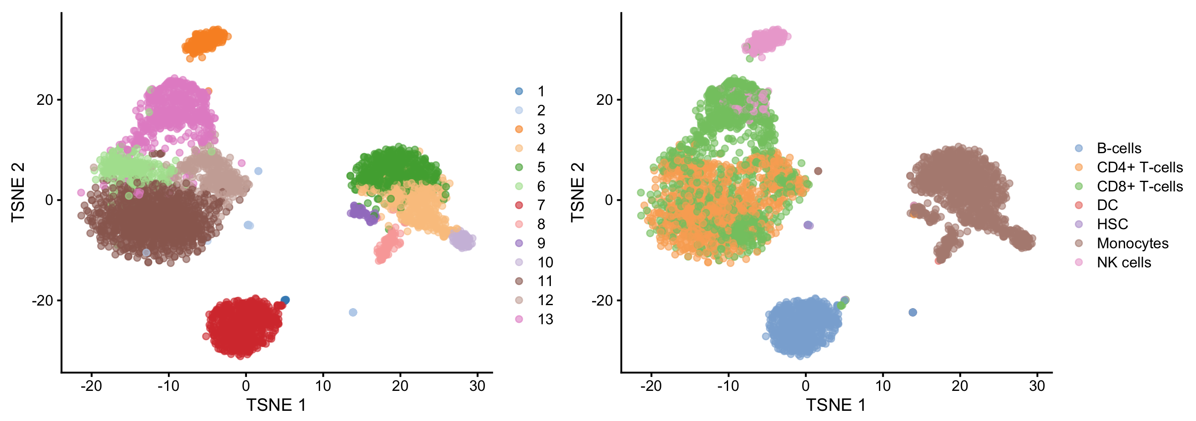
Automated cell type annotation using public marker databases
SingleR can rely on references of pure cell types to annotate individual cells within a scRNAseq dataset.
However, it is limited in sensitivity, as it can only identify cells based on the references used.
Aran et al., Nat. Immuno. 2019
10
Notes:
I would like to expand these observations to in vivo data. I also want to check what happens in terms of transcriptional dynamics in cells where Cyclin O, a key non-canonical cyclin involved in MCC diff., is knocked-out.

Slide 11
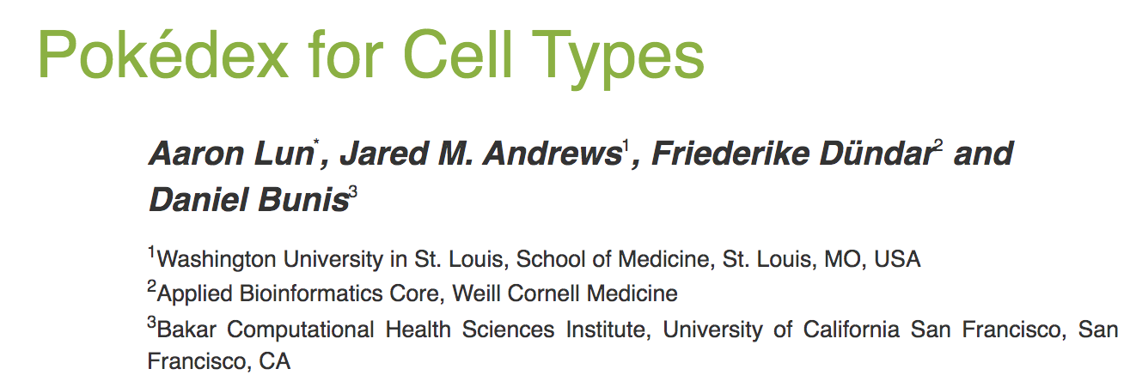
Automated cell type annotation using public marker databases
Celldex compiles transcriptome profiles for collections of “pure” cell types.
https://bioconductor.org/packages/release/data/experiment/vignettes/celldex/inst/doc/userguide.html
Aran et al., Nat. Immuno. 2019
11
Notes:
I would like to expand these observations to in vivo data. I also want to check what happens in terms of transcriptional dynamics in cells where Cyclin O, a key non-canonical cyclin involved in MCC diff., is knocked-out.

Slide 12
Automated cell type annotation using public marker databases
Celldex compiles transcriptome profiles for collections of “pure” cell types.
Human primary cell atlas (2013)
Blueprint/ENCODE (2012/2013)
Mouse RNA-seq (2019)
ImmGen project (microarrays from 2008…)
Database of Immune Cell Expression/eQTLs/Epigenomics (2018)
Novershtern hematopoietic data (microarrays from 2011…)
Monaco immune data (2019)
12
Notes:
I would like to expand these observations to in vivo data. I also want to check what happens in terms of transcriptional dynamics in cells where Cyclin O, a key non-canonical cyclin involved in MCC diff., is knocked-out.

Slide 13
Automated cell type annotation using public marker databases
Celldex compiles transcriptome profiles for collections of “pure” cell types and stores them in SummarizedExperiment objects.
reference_sumExp <- celldex::…
scExp <- …
predictions <- SingleR::SingleR(
test = scExp,
ref = reference_sumExp,
labels = reference_sumExp$label
)
13
Notes:
I would like to expand these observations to in vivo data. I also want to check what happens in terms of transcriptional dynamics in cells where Cyclin O, a key non-canonical cyclin involved in MCC diff., is knocked-out.

Slide 14
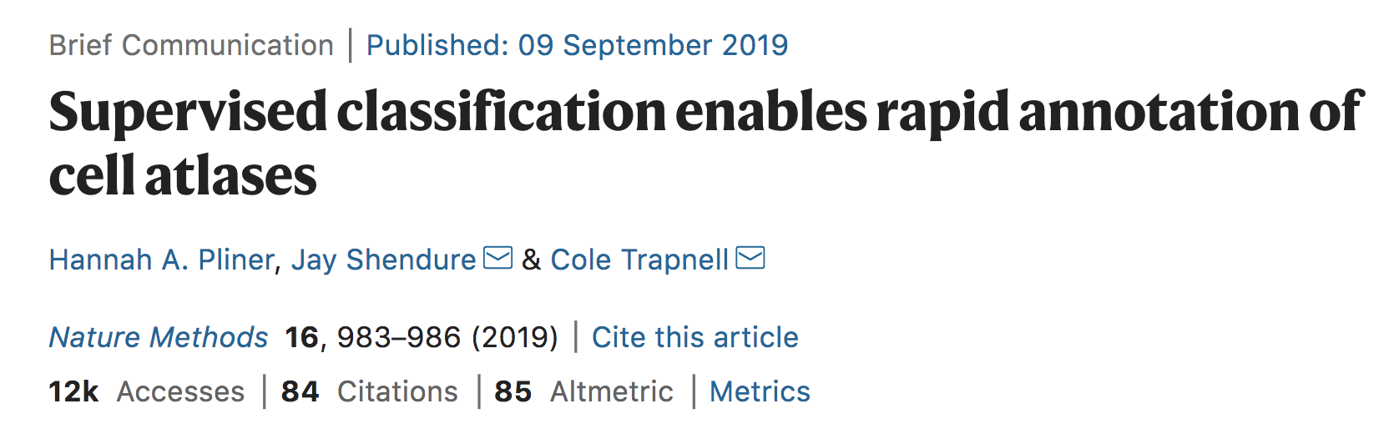
Garnett
Garnett relies on another approach to classify cells. It uses known cell type markers to train a regression classifier.
Pliner et al, Nat Methods 2019
14
Notes:
I would like to expand these observations to in vivo data. I also want to check what happens in terms of transcriptional dynamics in cells where Cyclin O, a key non-canonical cyclin involved in MCC diff., is knocked-out.

Slide 15
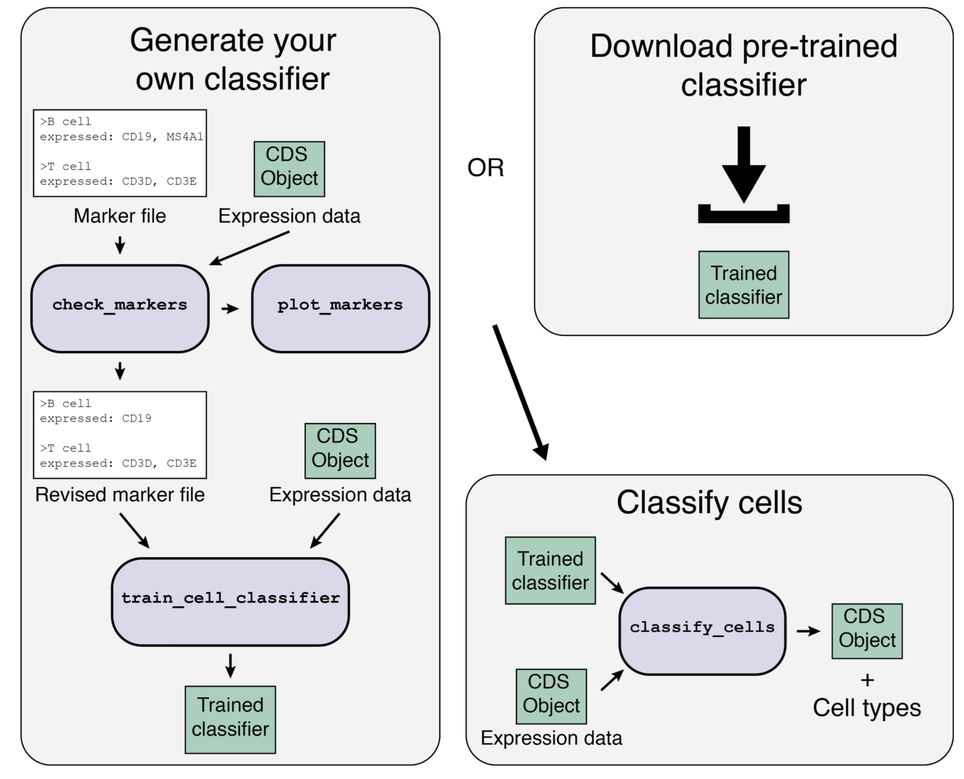
Garnett
Garnett relies on another approach to classify cells. It uses known cell type markers to train a regression classifier.
Pliner et al, Nat Methods 2019
15
Notes:
I would like to expand these observations to in vivo data. I also want to check what happens in terms of transcriptional dynamics in cells where Cyclin O, a key non-canonical cyclin involved in MCC diff., is knocked-out.

Slide 16
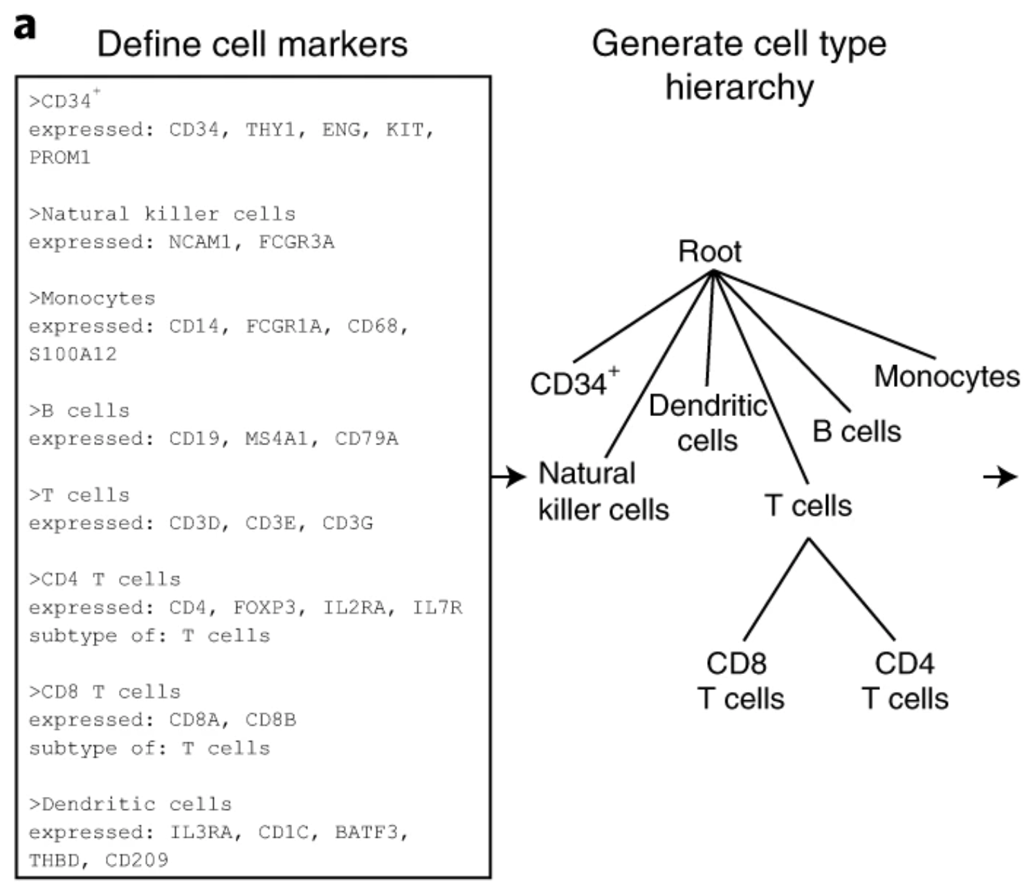
Garnett
Garnett relies on another approach to classify cells. It uses known cell type markers to train a regression classifier.
Pliner et al, Nat Methods 2019
16
Notes:
I would like to expand these observations to in vivo data. I also want to check what happens in terms of transcriptional dynamics in cells where Cyclin O, a key non-canonical cyclin involved in MCC diff., is knocked-out.

Slide 17
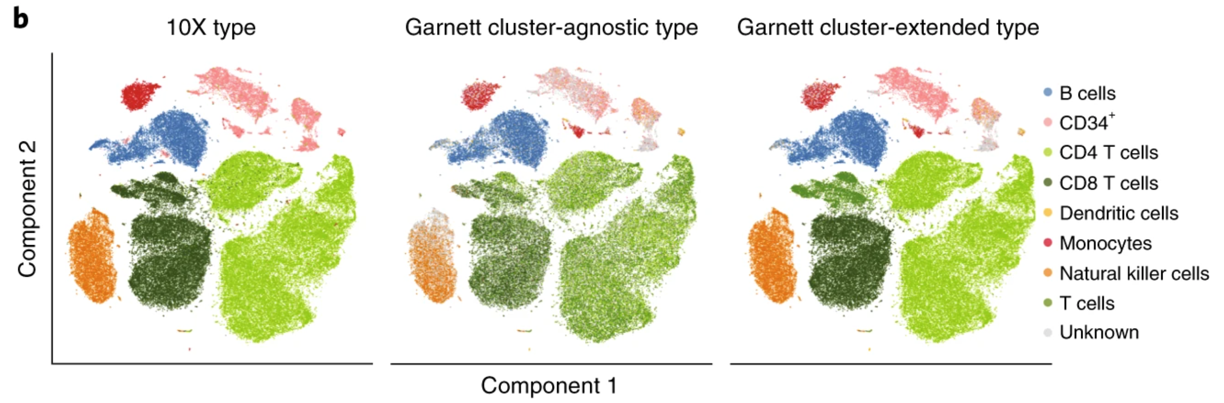
Garnett
Garnett can leverage cluster annotation to extend annotations.
Pliner et al, Nat Methods 2019
17
Notes:
I would like to expand these observations to in vivo data. I also want to check what happens in terms of transcriptional dynamics in cells where Cyclin O, a key non-canonical cyclin involved in MCC diff., is knocked-out.

Slide 18
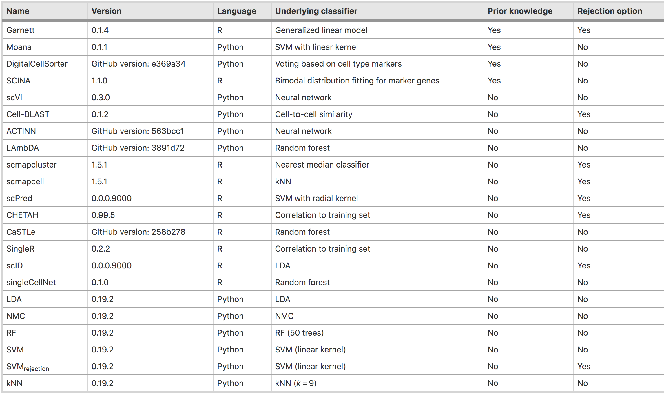
Automated cell type annotation using public marker databases
Huge (and growing!) collection of tools for automated cell annotation…
Abdelaal et al., Genome Biol. 2019
18
Notes:
I would like to expand these observations to in vivo data. I also want to check what happens in terms of transcriptional dynamics in cells where Cyclin O, a key non-canonical cyclin involved in MCC diff., is knocked-out.

Slide 19
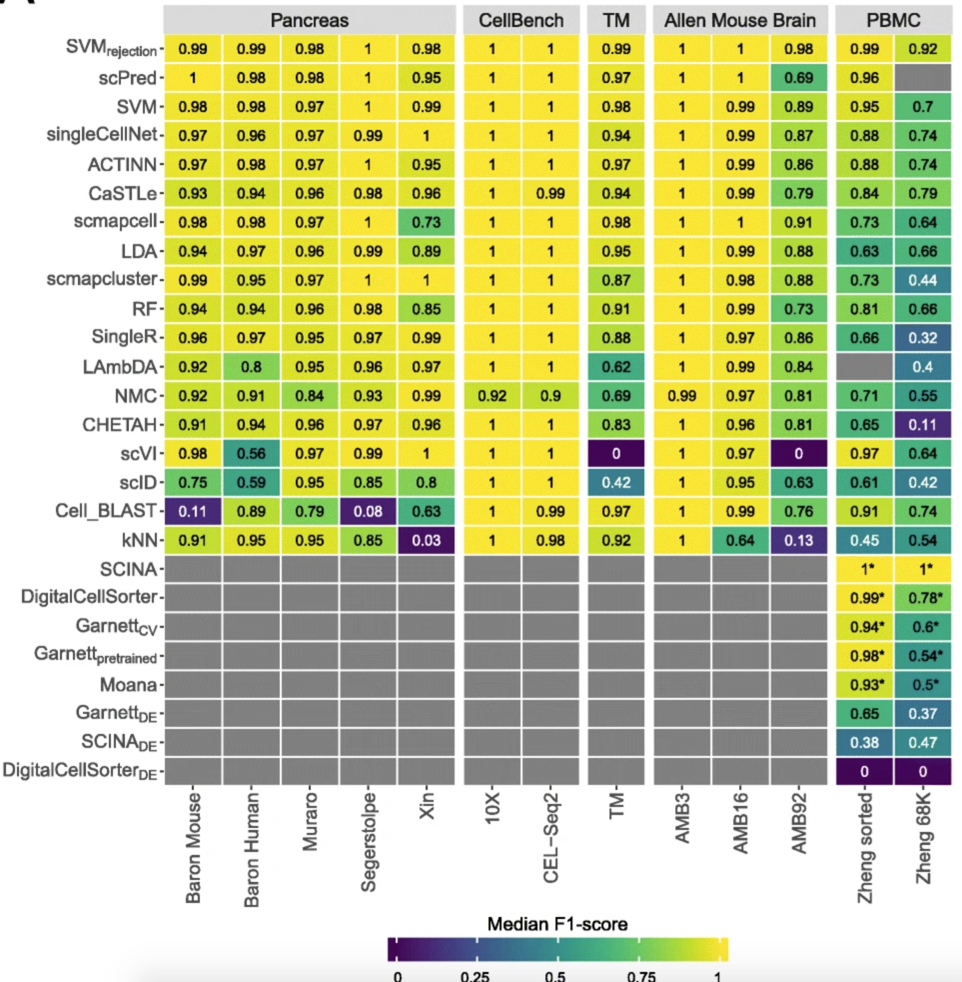
Automated cell type annotation using public marker databases
Huge (and growing!) collection of tools for automated cell annotation…
Abdelaal et al., Genome Biol. 2019
19
Notes:
I would like to expand these observations to in vivo data. I also want to check what happens in terms of transcriptional dynamics in cells where Cyclin O, a key non-canonical cyclin involved in MCC diff., is knocked-out.

Slide 20
Analysis workflow
Pre-Processing
Clustering
Biology
Expression Matrix
(GENES x CELLS)
1. Identify
Variable Genes
5. Differentially Expressed Genes
Filter Cells /
Quality Control
2. Dimensionality Reduction
6. Assigning
Cell Type
Normalization
3. Clustering
7. Functional Annotation
4. Explore (known)
marker genes
Notes:
I would like to expand these observations to in vivo data. I also want to check what happens in terms of transcriptional dynamics in cells where Cyclin O, a key non-canonical cyclin involved in MCC diff., is knocked-out.

